Slide 1

Project 2 – Jobs Analysis
Adzuna Job Search

Slide 2
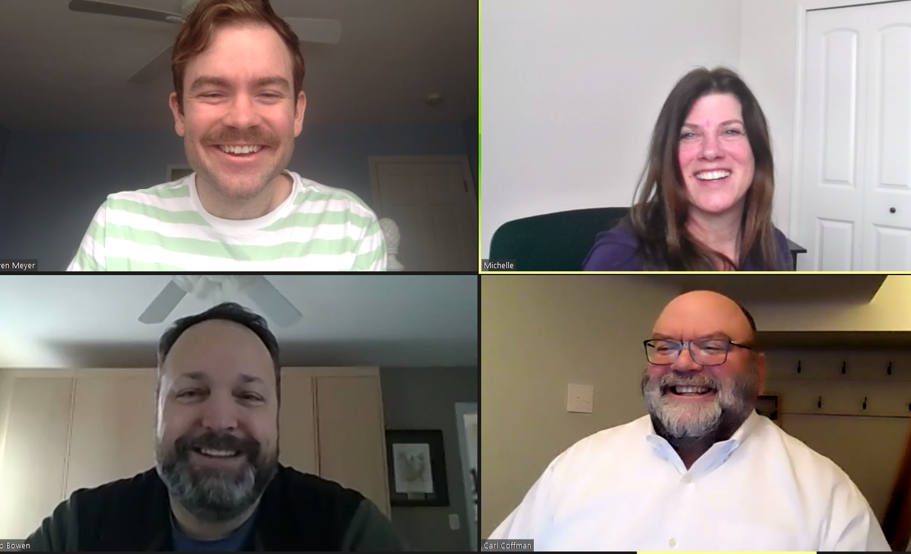
Meet the dream team!
Owen Meyer
Michelle Bannon
Rob Bowen
Carl Coffman

Slide 3






Project Challenges
Getting data
Getting data:
API’s required a paid subscription
Indeed (restricted number of pages)
LinkedIn
Glass Door
ParsHub
Decided on an API for Adzuna - salary info was generally null
Running out of our API data, exceeding our daily limit
Getting good data from the API; Less than 5% had salary data

Slide 4


Project challenges Continued
GIT HUB SAYS YOUR CHANGES ARE

Slide 5
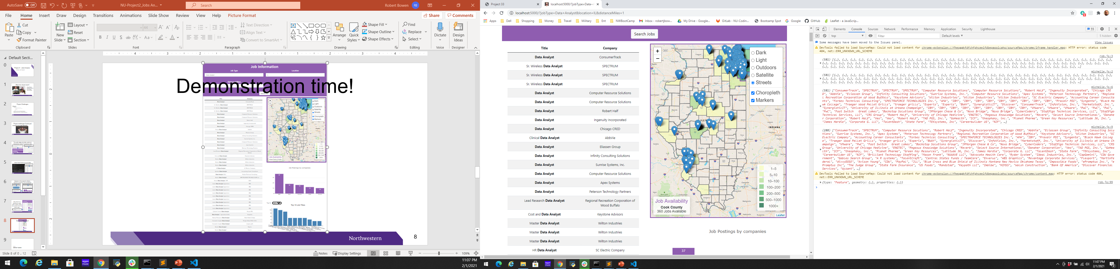
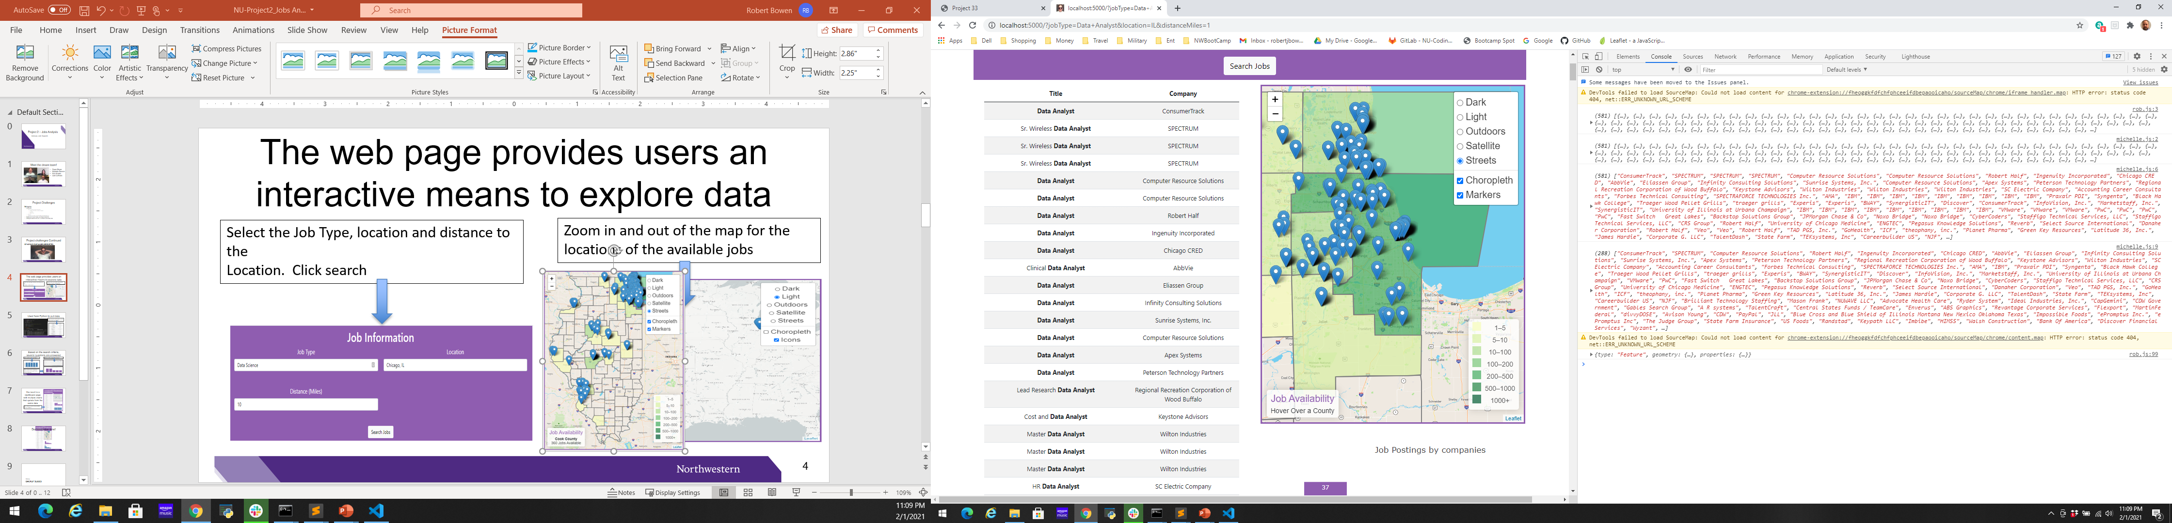
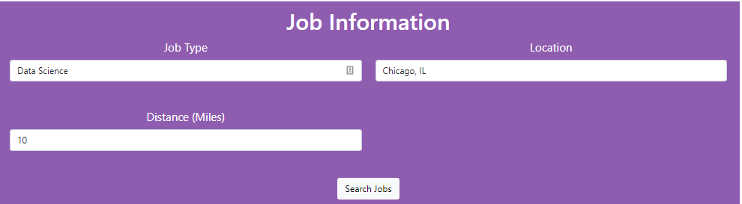
The web page provides users an interactive means to explore data
Select the Job Type, Location and Search Radius Distance from the Location.
Click “Search Jobs”
Zoom in and out of the map for the locations of the available jobs on click
On-click

Slide 6
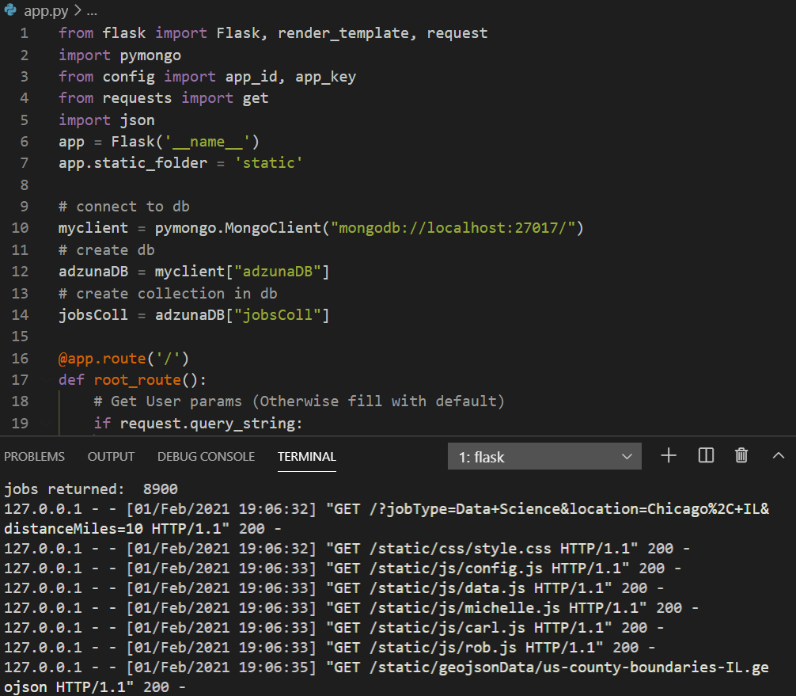
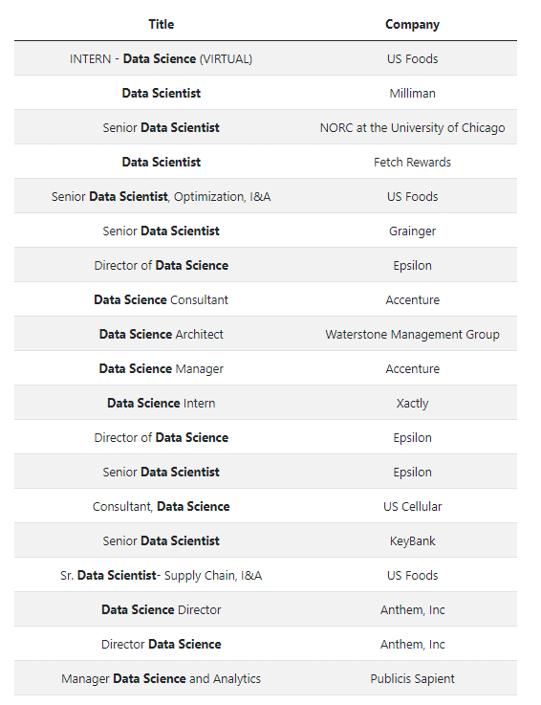
Used flask Python to pull data
Flask returned all the jobs for that job, location and radius

Slide 7
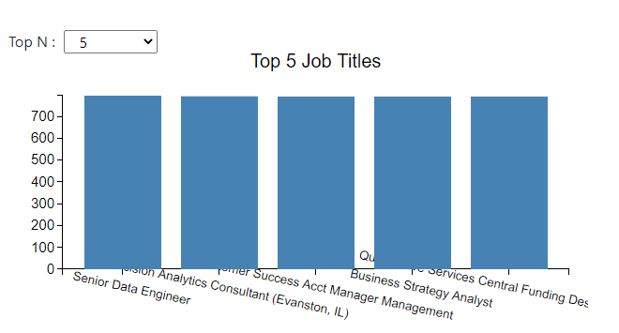
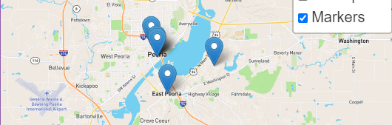
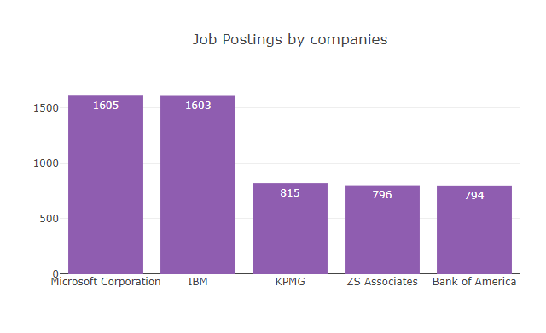
Based on the search criteria, several questions are answered
What are the top 5 Job Titles?
Where are the companies located?
What are the top 5 companies that have the most jobs for the selected job title?

Slide 8
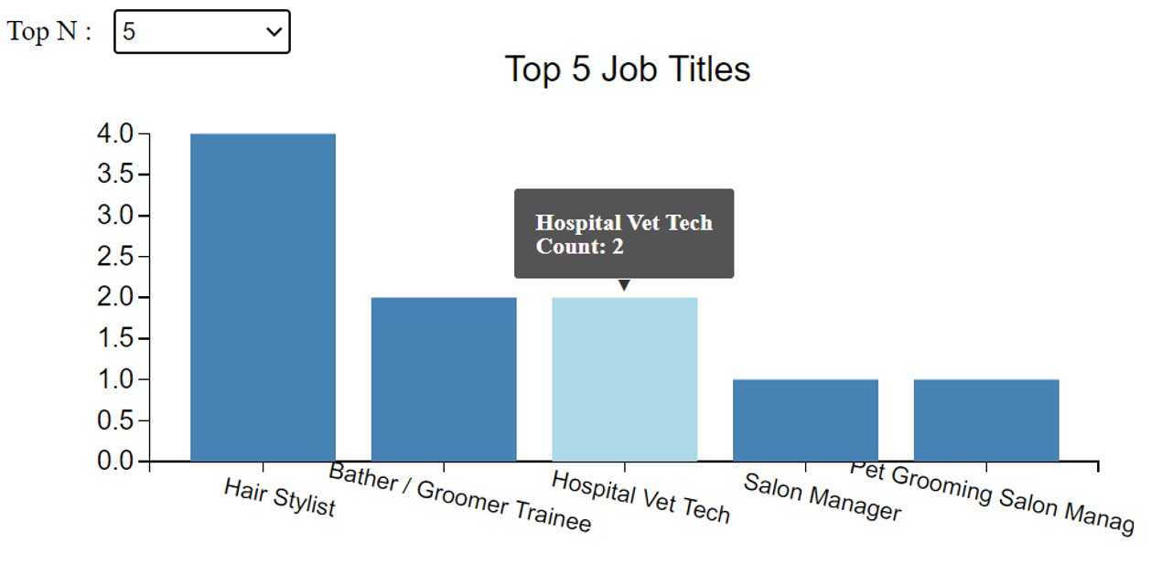
Based on the search criteria, several questions are answered
What are the top 5 Job Titles?
Where are the companies located?
What are the top 5 companies that have the most jobs for the selected job title?

Slide 9
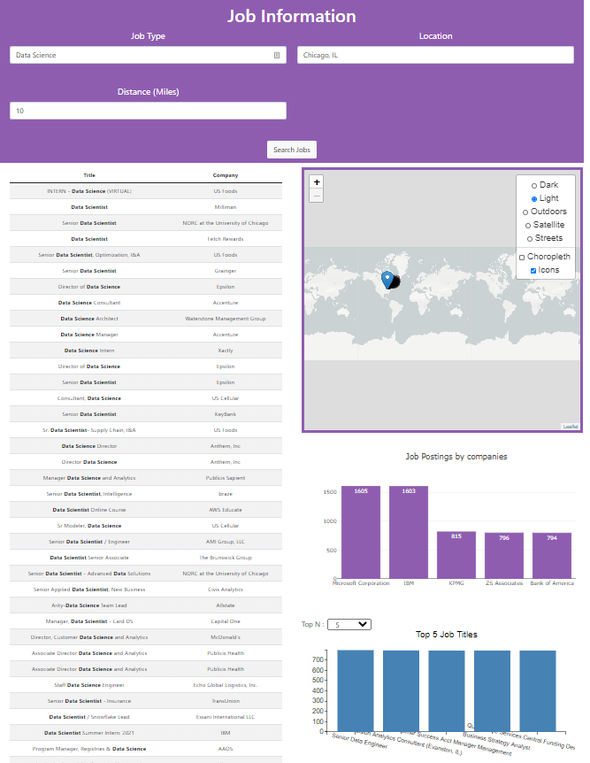
The result is a dashboard page with multiple charts that update from the same data
Data Science search returned 8900 records (YIKES!)

Slide 10
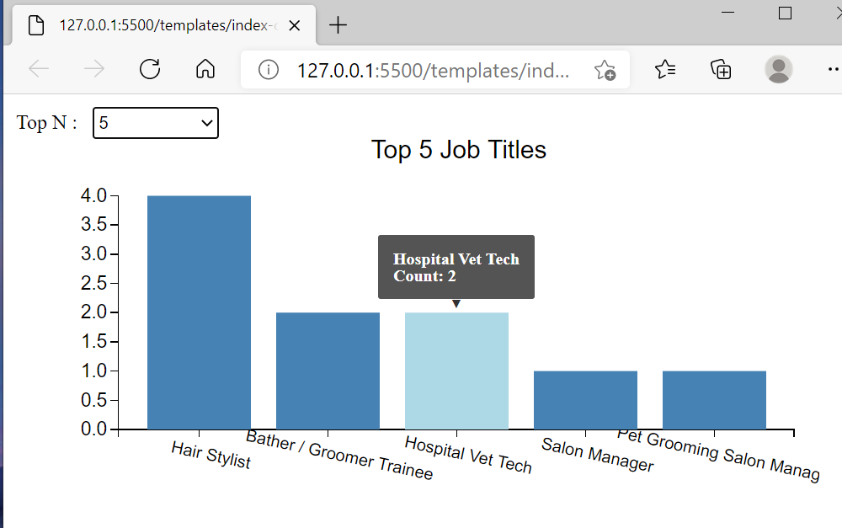
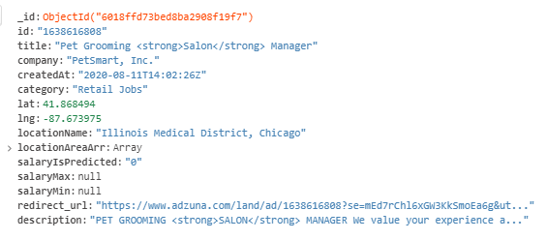
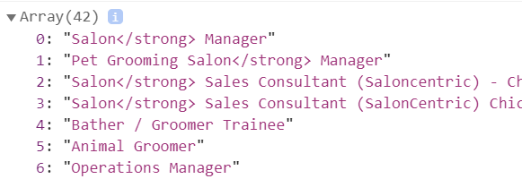
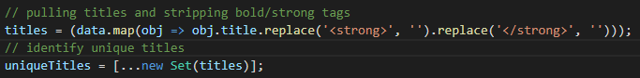
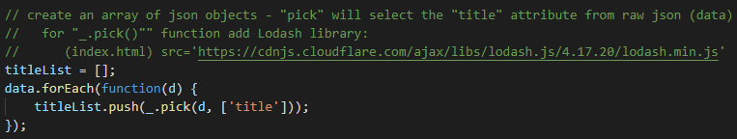
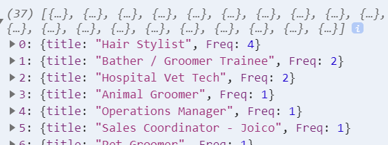

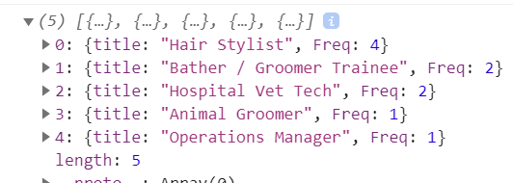
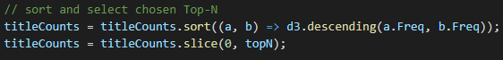
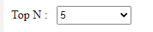
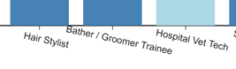
Grooming Data for Top-N

Slide 11

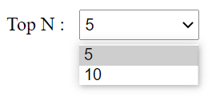

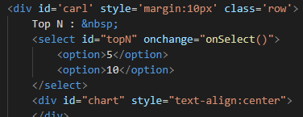
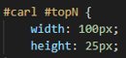
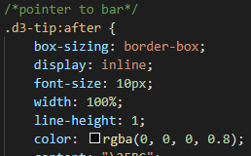
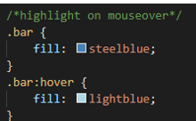
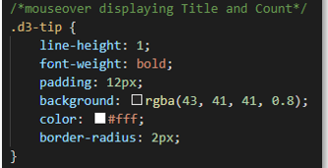
Charting Top-N with D3/SVG

Slide 12
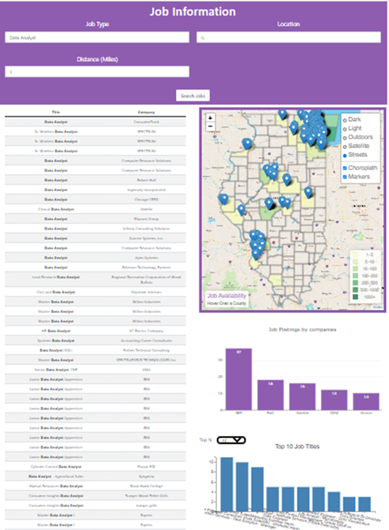
Demonstration time!

Slide 13
BACKUP SLIDES
Backup

Slide 14
